Slide 1
Decoding in a text.
Phonemes and spelling patterns | With adult modelling, I can identify phonemes in words.  I can see the phonemes within words and use self-scaffolding and classroom support to identify them.  I can identify the phonemes and spelling patterns we have learnt within a word independently.  I can explain to others how the phonemes and spelling patterns in a word help me read it.
Segmenting & blending | ★ With adult modelling, I can blend sounds together.  I can see sounds in a words and blend them out loud.  I can see the sounds and blend them in my head.  I can read most words on sight.
Prefixes and suffixes | ★ With adult modelling, I can identify suffixes and prefixes and work together to read them.  I can recognise and read suffixes and prefixes using self-scaffolding and classroom support.  I can recognise and read suffixes and prefixes on sight.  I can explain to others how the prefixes or suffixes in a word help me read it.
Using syllables | ★ With adult modelling, I can identify syllables in a words and work together to read them.  I can identify syllables in a word and use these to read the word aloud independently.  I can identify and use syllables to read a word in my head.  I can explain to others how syllables in a word can help me read it.
Challenging words | ★ With adult modelling, I can discuss words I will find challenging to read and work together to read them.  I can recognise words that I find challenging to read and ask for prompts and clues if I am stuck.  I can recognise words that I find challenging to read and use self-scaffolding strategies to read these.  I can explain to others why a word is challenging and suggest strategies they could use to read it.

Slide 2

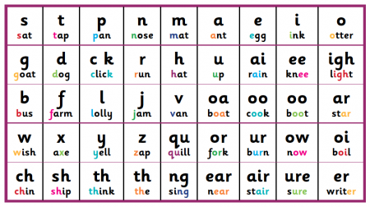


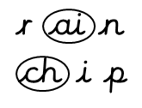


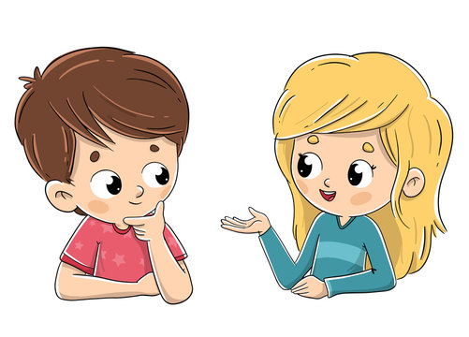
Phonemes and spelling patterns | With adult modelling, I can identify phonemes in words.  I can see the phonemes within words and use self-scaffolding and classroom support to identify them.  I can identify the phonemes and spelling patterns we have learnt within a word independently.  I can explain to others how the phonemes and spelling patterns in a word help me read it.
r ai n
ch i p

Slide 3
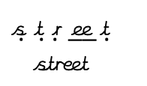

Segmenting & blending | ★ With adult modelling, I can blend sounds together.  I can see sounds in a words and blend them out loud.  I can see the sounds and blend them in my head.  I can read most words on sight.
__
. . . .
s t r ee t
street

Slide 4
Prefixes and suffixes | With adult modelling, I can identify suffixes and prefixes and work together to read them.  I can recognise and read suffixes and prefixes using self-scaffolding and classroom support.  I can recognise and read suffixes and prefixes on sight.  I can explain to others how the prefixes or suffixes in a word help me read it.
playing
shouted
unhappy
un-
-est
-ing
re-
-ed
dis-
-ful
-er
playing
shouted
unhappy
playing
shouted
unhappy

Slide 5
Using syllables | With adult modelling, I can identify syllables in a words and work together to read them.  I can identify syllables in a word and use these to read the word aloud independently.  I can identify and use syllables to read a word in my head.  I can explain to others how syllables in a word can help me read it.
el – e –phant
elephant
el – e –phant
elephant
elephant
el – e –phant
elephant

Slide 6

Challenging words | ★ With adult modelling, I can discuss words I will find challenging to read and work together to read them.  I can recognise words that I find challenging to read and ask for prompts and clues if I am stuck.  I can recognise words that I find challenging to read and use self-scaffolding strategies to read these.  I can explain to others why a word is challenging and suggest strategies they could use to read it.
ancient
Can you give me a clue?
How can I
work out what
the word says?
I can see
an at the start and
ent at the end. The
ci can make a
ch sound.

