Slide 1
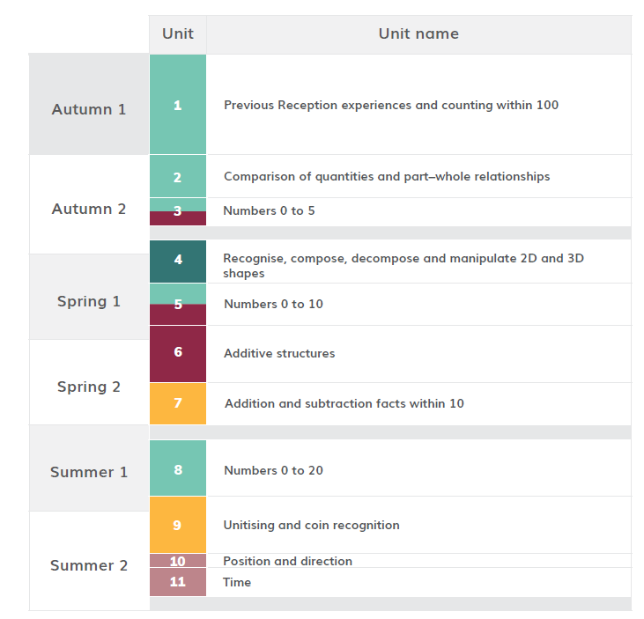

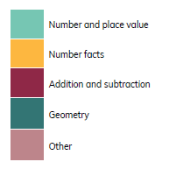
HOH Academic year 21-22
*Please note than these are approximate dates based on Leicestershire term dates. This plan will help to keep teachers on track with coverage but teachers may makes slight changes based on monitoring and assessment. This plan will be reviewed in Sept 22.
≈7 WEEKS 30thAug –Oct 15th
≈ 3 WEEKS 25th Oct- 12th Nov
≈2 WEEKS 15th Nov- 26th Nov
≈ 3WEEKS 29th Nov-17^{h} Dec
≈ 3 WEEKS Jan 3rd- Jan 21st
≈4 WEEKS Jan 24th – Feb 25th
≈3 WEEKS Feb 28th – March 18th
≈ 4 WEEKS 21st March – 29th April
≈ 5 WEEKS 2nd May- 3rd June
≈1 WEEK 6th June-10th June
≈2 WEEKS -13th June- 24th June

Slide 2
https://www.ncetm.org.uk/classroom-resources/cp-year-1-curriculum-map/
Links to online materials to support planning
unit | Time allocation Approximate* | Main Focus and link to materials to support planning | Links to Maths Guidance | Links to PD materials
1 | 7 Weeks 30th- October 15th | Previous Reception experiences and counting within 100 | 1NPV 1 | 1.9 Composition of numbers: 20-100
2 | ≈ 3 WEEKS 25th Oct- 12th Nov | Comparison of quantities and part–whole relationships | 1NPV 1 1NPV 2 | 1.1 Comparison of quantities and measures 1.2 Introducing ‘whole’ and ‘parts’: part-part-whole
3 | ≈2 WEEKS 15th Nov- 26th Nov | Numbers 0 to 5 | 1NPV 2 1 AS 2 | 1.3 Composition of numbers: 0–5
4 | ≈ 3WEEKS 29th Nov-17^{h} Dec | Recognise, compose, decompose and manipulate 2D and 3D shapes | 1G1 1G2 | See Maths Guidance 1G1 and 1 G2 Page 42-46
5 | ≈ 3 WEEKS Jan 3rd- Jan 21st | Numbers 0 to 10 | 1NPV 2 1AS1 | 1.4 Composition of numbers: 6 to 10

Slide 3
https://www.ncetm.org.uk/classroom-resources/cp-year-1-curriculum-map/
Links to online materials to support planning
unit | Time allocation Approximate* | Main Focus and link to materials to support planning | Links to Maths Guidance | Links to PD materials
6 | ≈4 WEEKS Jan 24th – Feb 25th | Additive Structures | 1 AS 2 | 1.5 Additive structures: introduction to aggregation and partitioning 1.6 Additive structures: introduction to augmentation and reduction
7 | 3 WEEKS Feb 28th – March 18th | Addition and subtraction facts within 10 | 1NF 1 | 1.7 Addition and subtraction: strategies within 10
8 | ≈ 4 WEEKS 21st March – 29th April | Numbers 0 to 20 | 1 NPV 2 | 1:10 Composition of numbers: 11-19
9 | ≈ 5 WEEKS 2nd May- 10th June | Unitising and coin recognition | 1 NF 2 | 2.1 Counting, unitising and coins
10 | ≈1 WEEK 13th June-17 June | Position and direction | This topic is part of the National Curriculum but is not included in the DfE 2020 guidance or the NCETM Mastery PD Materials. There are no NCETM classroom slides to download for this unit https://www.ncetm.org.uk/classroom-resources/cp-year-1-unit-10-position-and-direction-2-1-1/
11 | 2 WEEKS -20th June- 1st July | Time | This topic is part of the National Curriculum but is not included in the DfE 2020 guidance or the NCETM Mastery PD Materials. There are no NCETM classroom slides to download for this unit https://www.ncetm.org.uk/classroom-resources/cp-year-1-unit-11-time/

