Slide 1

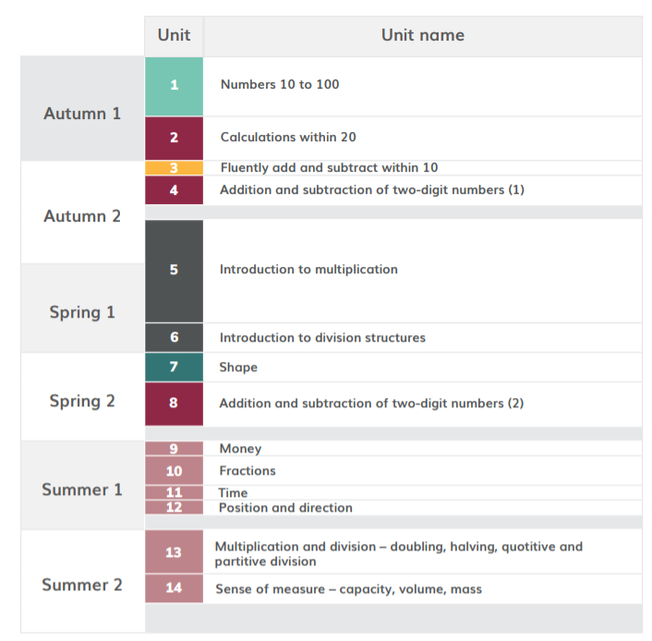
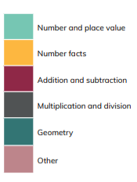
HoH Academic year
*Please note than these are approximate dates based on Leicestershire term dates. This plan will help to keep teachers on track with coverage but teachers may makes slight changes based on monitoring, assessment and KS1 SATS. This plan will be reviewed in Sept 22.
≈4 WEEKS Aug 30th- Sept 24th
≈ 3 WEEKS 27th Sept- 15th Oct
≈2 WEEKS 25th – 12th Nov
≈ 2WEEKS 15th Nov- 26th Nov
≈ 7 WEEKS 29th Nov- 28th January
≈ 2 weeks 31st Jan- 11th Feb
≈ 2 weeks 21st Feb- 4th March
≈ 3 weeks 7th March- 25th March
≈ 1 week 28th March – 1st April
≈ 2 week 4th April- 29th April
≈ 1 week 9th May- 13th May
≈ 1 week 16th May- 21st May
≈ 3 weeks 23rd May- 17th June
≈ 2 weeks 19th June- 30th June

Slide 2
https://www.ncetm.org.uk/classroom-resources/cp-year-2-curriculum-map/
Links to online materials to support planning
unit | Time allocation Approximate* | Main Focus and link to materials to support planning | Links to Maths Guidance | Links to PD materials
1 | ≈4 WEEKS Aug 30th- Sept 24th | Numbers 10 to 100 | 2NPV 1 2NPV 2 | 1.8 Composition of numbers: multiples of 10 up to 100 1.9 Composition of numbers: 20-100
2 | ≈ 3 WEEKS 27th Sept- 15th Oct | Calculations within 20 | 2AS 1 2AS 2 | 1.11 Addition and subtraction: bridging 10 1.12 Addition and subtraction: subtraction as difference
3 | ≈2 WEEKS 25th – 12th Nov | Fluently Add and Subtract within 10 | 2NF 1 | 1.7 Addition and Subtraction: strategies within ten
4 | ≈ 2WEEKS 15th Nov- 26th Nov | Addition and Subtraction of two-digit numbers – part 1 | 2AS 3 | 1.13 Addition and Subtraction: two-digit and single-digit numbers 1.14 Addition and Subtraction: two-digit numbers and multiples of ten

Slide 3
unit | Time allocation Approximate* | Main Focus and link to materials to support planning | Links to Maths Guidance | Links to PD materials
5 | ≈ 7 WEEKS 29th Nov- 28^{tt} January | Introduction to Multiplication | 2MD 1 | 2.2 Structures: multiplication representing equal groups 2.3 Times tables: groups of 2 and commutativity (part 1) 2.4 Times tables: groups of 10 and of 5, and factors of 0 and 1 2.5 Commutativity (part 2), doubling and halving
6 | ≈ 2 weeks 31st Jan- 11th Feb | Introduction to division structures | 2MD 2 | 2.6 Structures: quotitive and partitive division
7 | ≈ 2 weeks 21st Feb- 4th March | Shape | 2G 1 | See Maths Guidance 2G-1 Page 74
8 | ≈ 3 weeks 7th March- 25th March | Addition and subtraction of two-digit numbers | 2AS 4 | 1.15 Addition: two-digit and two-digit numbers 1.16 Subtraction: two-digit and two-digit numbers

Slide 4
unit | Time allocation Approximate* | Main Focus and link to materials to support planning | Links to Maths Guidance | Links to PD materials
9 | ≈ 1 week 28th March – 1st April | Money | This topic is part of the National Curriculum but is not included in the DfE 2020 guidance or the NCETM Mastery PD Materials. There are no NCETM classroom slides to download for this unit. https://www.ncetm.org.uk/classroom-resources/cp-year-2-unit-9-money/
10 | ≈ 2 week 4th April- 29th April | Fractions | n/a | 3.0 Guidance on the teaching of fractions in Key Stage 1
SATS
11 | ≈ 1 week 9th May- 13th May | Time | This topic is part of the National Curriculum but is not included in the DfE 2020 guidance or the NCETM Mastery PD Materials. There are no NCETM classroom slides to download for this unit. https://www.ncetm.org.uk/classroom-resources/cp-year-2-unit-11-time/
12 | ≈ 1 week 16th May- 21st May | Position and direction | This topic is part of the National Curriculum but is not included in the DfE 2020 guidance or the NCETM Mastery PD Materials. There are no NCETM classroom slides to download for this unit. https://www.ncetm.org.uk/classroom-resources/cp-year-2-unit-11-time/ https://www.ncetm.org.uk/classroom-resources/cp-year-2-unit-12-position-and-direction/
13 | ≈ 3 weeks 23rd May- 17th June | Multiplication and division- doubling, halving quotative and partitive division | n/a | 2.5 Commutativity (part 2), doubling and halving 2.6 Structures: quotitive and partitive division
14 | ≈ 2 weeks 19th June- 30th June | Sense of Measure- capacity, volume, mass | This topic is part of the National Curriculum but is not included in the DfE 2020 guidance or the NCETM Mastery PD Materials. There are no NCETM classroom slides to download for this unit. https://www.ncetm.org.uk/classroom-resources/cp-year-2-unit-14-sense-of-measure-capacity-volume-mass/

