Slide 1

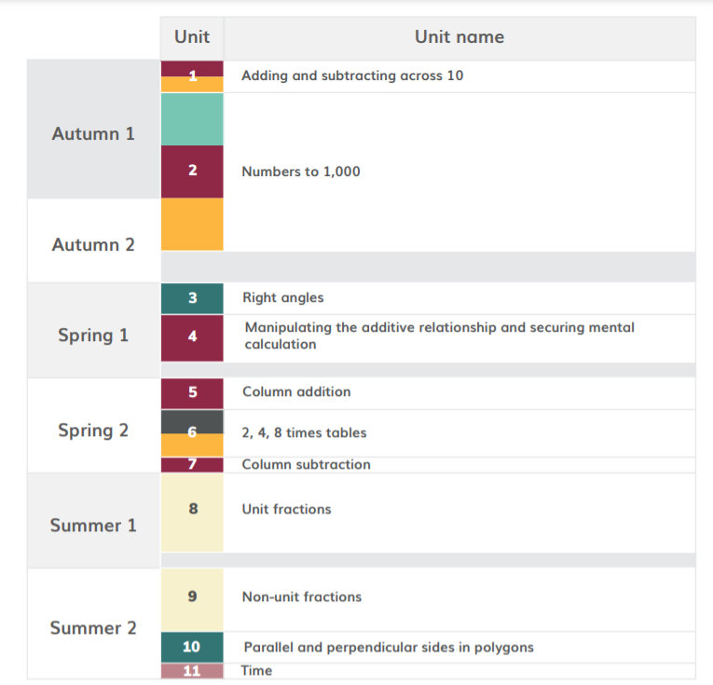
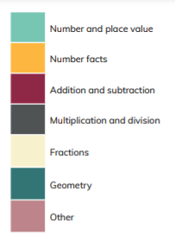
HoH Academic year
*Please note than these are approximate dates based on Leicestershire term dates. This plan will help to keep teachers on track with coverage but teachers may makes slight changes based on monitoring, assessment and KS1 SATS. This plan will be reviewed in Sept 22.
≈2 WEEKS Aug 20th – Sept 10th
≈ 10 WEEKS 13th ^{h} Sept- 26th Nov
≈ 2WEEKS 29th Nov -13th December
≈ 4WEEKS 16th Dec-21st January
≈2 WEEKS 24th Jan – 4th Feb
≈3 WEEKS 7th Feb- 4th March
≈1 WEEK 7th-11th March
≈ 5 WEEKS 14th March- 29th April
≈ 4 WEEKS 2nd May- 27th May
≈ 2 WEEKS 6th June- 17th June
≈ 1 WEEK 20th June – 24th June

Slide 2
https://www.ncetm.org.uk/classroom-resources/cp-year-3-curriculum-map/
Links to online materials to support planning
unit | Time allocation Approximate | Main Focus and link to materials to support planning | Links to Maths Guidance | Links to PD materials
1 | ≈2 WEEKS Aug 20th – Sept 10th | Adding and Subtracting across 10 | 2AS1 3NF1 | 1.11 Addition and subtraction: bridging 10
2 | ≈ 10 WEEKS 13th Sept- 26th Nov | Numbers to 1000 | 3NPV1 3NPV2 3NPV3 3NPV4 3NF3 3AS1 | 1.17 Composition and Calculation: 100 and bridging 100 1.18 Composition and calculation: three-digit numbers
3 | ≈ 2WEEKS 29th Nov -13th December | Right angles | 3G1 | See Maths Guidance 3G1 Pages 134-137
4 | ≈ 4WEEKS 16th Dec-21st January | Manipulating the additive relationship and securing mental calculations | 3AS3 | 1.19 Securing Mental Strategies: calculation up to 999 + 3AS3 pg 113-116
5 | ≈2 WEEKS 24th Jan – 4th Feb | Column Addition | 3AS2 | 1.20 Algorithms: column addition

Slide 3
https://www.ncetm.org.uk/classroom-resources/cp-year-3-curriculum-map/
Links to online materials to support planning
unit | Time allocation Approximate | Main Focus and link to materials to support planning | Links to Maths Guidance | Links to PD materials
6 | ≈3 WEEKS 7th Feb- 4th March | 2,4,8 times tables | 3NF 2 3MD 1 3NF 3 | 2.7 Times tables: 2, 4 and 8 and the relationship between them
7 | ≈1 WEEK 7th-11th March | Column subtraction | 3AS 2 | 1.21 Algorithms: column subtraction
8 | ≈ 5 WEEKS 14th March- 29th April | Unit Fractions | 3F 1 3F2 | 3.1 Preparing for fractions: the part whole relationship 3.2 Unit fractions: identifying, representing and comparing
9 | ≈ 4 WEEKS 2nd May- 27th May | Non-unit fractions | 3F 1 3F 3 3F 4 | 3.3 Non-unit fractions: identifying, representing and comparing 3.4 Adding and subtracting within one whole
10 | ≈ 2 WEEKS 6th June- 17th June | Parallel and perpendicular sides and polygons | 3G 2 | See Maths Guidance 3G2 pg 137
11 | ≈ 1 WEEK 20th June – 24th June | Time | This topic is part of the National Curriculum but is not included in the DfE 2020 guidance or the NCETM Mastery PD Materials. There are no NCETM classroom slides to download for this unit. https://www.ncetm.org.uk/classroom-resources/cp-year-3-unit-11-time/

