Slide 1

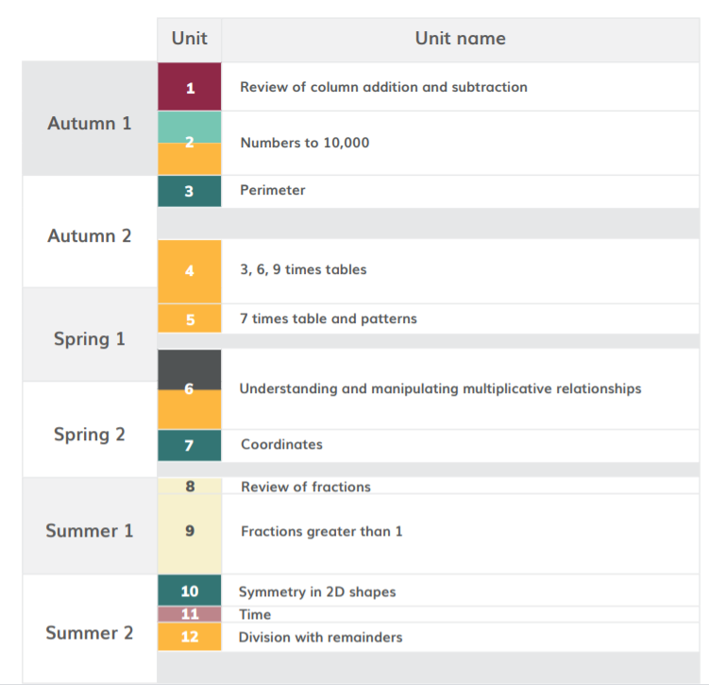
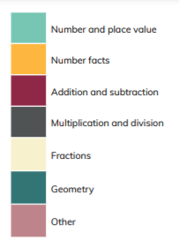
HoH Academic year
*Please note than these are approximate dates based on Leicestershire term dates. This plan will help to keep teachers on track with coverage but teachers may makes slight changes based on monitoring, assessment and KS1 SATS. This plan will be reviewed in Sept 22.
≈3 WEEKS Aug 30th – Sept 17h
≈ 5 WEEKS Sept 20^{th–} Oct 29th
≈ 2 WEEKS 1st Nov- 12th
≈ 4 WEEKS 15th Nov- 10th Dec
≈ 2 WEEKS 13th Dec- Jan 7th
≈ 5 WEEKS Jan 10th- Feb 11th
≈ 2 WEEKS Feb 21st- March 4th
≈ 1 WEEK March 7th- March 11th
5 WEEKS
March 14th- April 29th
≈ 2 WEEKS May 2nd- May 13th
≈ 1 WEEK May 16th- 20th
≈ 2 WEEKS May 23rd- 9th June

Slide 2
https://www.ncetm.org.uk/classroom-resources/cp-year-4-curriculum-map/
Links to online materials to support planning
unit | Time allocation Approximate | Main Focus and link to materials to support planning | Links to Maths Guidance | Links to PD materials
1 | ≈3 WEEKS Aug 30th – Sept 17h | Review of column addition and subtraction | 3AS2 | 1.20 Algorithms: column addition 1.21 Algorithms: column subtraction
2 | ≈ 5 WEEKS Sept 20^{th–} Oct 29th | Numbers to 1000 | 4NPV1 4NPV2 4NPV3 4NPV4 4NF3 | 1.22 Composition and calculation: 1,000 and four-digit numbers.
3 | ≈ 2 WEEKS 1st Nov- 12th | Perimeter | 4G2 | 2.16 Multiplicative contexts: area and perimeter 1
4 | ≈ 4 WEEKS 15th Nov- 10th Dec | 3,6, 9 Times tables | 4NF1 | 2.8 Times Tables: 3, 6 and 9, and the relationship between them

Slide 3
unit | Time allocation Approximatate | Main Focus and link to materials to support planning | Links to Maths Guidance | Links to PD materials
5 | ≈ 2 WEEKS 13th Dec- Jan 7th | 7 times tables and patterns | 4NF1 | 2.9 Times Tables: 7 and patterns within / across times tables
6 | ≈ 5 WEEKS Jan 10th- Feb 11th | Understanding and manipulating multiplicative relationships | 4MD 1 4MD 2 4MD 3 4NF 3 | 2.10 Connecting multiplication and division, and the distributive law 2.13 Calculation: multiplying and dividing by 10 and 100
7 | ≈ 2 WEEKS Feb 21st- March 4th | Coordinates | 4 G1 | See Maths Guidance for 4G1
8 | ≈ 1 WEEK March 7th- March 11th | Review of fractions | 3 F1 | 3.1 Preparing for fractions: the part whole relationship
9 | ≈ 5 WEEKS March 14th- April 29th | Fractions greater than 1 | 4F 1 4F 2 4 F3 | 3.5 Working across one whole: improper fractions and mixed numbers
10 | ≈ 2 WEEKS May 2nd- May 13th | Symmetry in 2D shapes | 4 G3 | See Maths Guidance for 4G3
11 | ≈ 1 WEEK May 16th- 20th | Time | This topic is part of the National Curriculum but is not included in the DfE 2020 guidance or the NCETM Mastery PD Materials. There are no NCETM classroom slides to download for this unit. https://www.ncetm.org.uk/classroom-resources/cp-year-4-unit-11-time/
12 | ≈ 2 WEEKS May 23rd- 9th June | Division with remainders | 4 NF 2 | 2.12 Division with remainders

