Slide 1

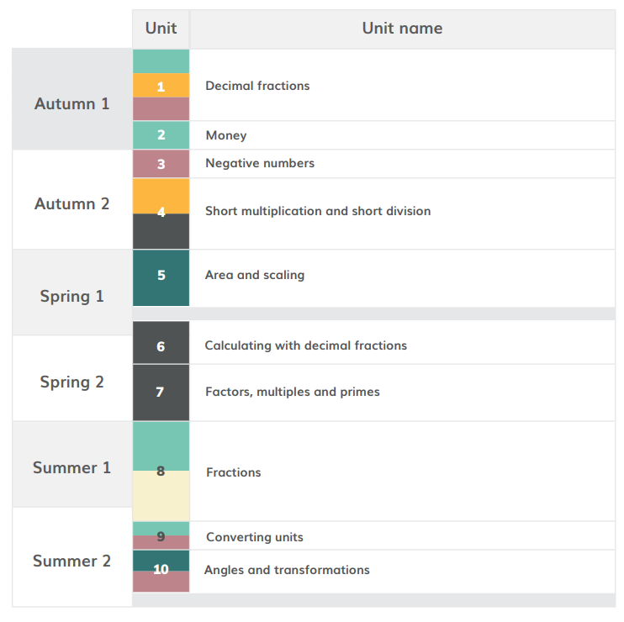
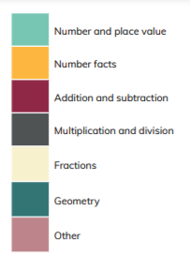
HoH Academic year
*Please note than these are approximate dates based on Leicestershire term dates. This plan will help to keep teachers on track with coverage but teachers may makes slight changes based on monitoring and assessment. This plan will be reviewed in Sept 22.
≈5 WEEKS Aug 30th – 1st Oct
≈ 3 WEEKS 1st Oct-– Oct 29th
≈ 2 WEEKS 1st Nov- 12^{h} Nov
≈ 6 WEEKS 15th Nov- Jan 7th
≈ 5WEEKS 10th Jan – 18th Feb
≈3 WEEKS 21st Feb- March 11th
≈4 WEEKS 14th March – 8th April
≈7 WEEKS 25th April – 27th May
≈2 WEEKS 6th June- 17th June
≈3 WEEKS
20th June- 8th July

Slide 2
https://www.ncetm.org.uk/classroom-resources/cp-year-5-curriculum-map/
Links to online materials to support planning
unit | Time allocation Approximate | Main Focus and link to materials to support planning | Links to Maths Guidance | Links to PD materials
1 | ≈5 WEEKS Aug 30th – 1st Oct | Decimal Fractions | 5NPV1 5NPV2 5NPV3 5NPV4 5NF2 | 1.23 Composition and calculation: tenths 1.24 Composition and calculation: hundredths and thousandths
2 | ≈ 3 WEEKS 1st Oct-– Oct 29th | Money | n/a | 1.25 Addition and subtraction: money
3 | ≈ 2 WEEKS 1st Nov- 12^{h} Nov | Negative Numbers | n/a | 1.27 Negative numbers: counting, comparing and calculating
4 | ≈ 6 WEEKS 15th Nov- Jan 7th | Short multiplication and short division | 5MD3 5MD4 | 2.14 Multiplication: partitioning leading to short multiplication 2.15 Division: partitioning leading to short division
5 | ≈ 5 WEEKS 10th Jan – 11th Feb | Area and Scaling | 5G2 | 2.16 Multiplicative contexts: area and perimeter 1 2.17 Structures: using measures and comparison to understand scaling

Slide 3
https://www.ncetm.org.uk/classroom-resources/cp-year-5-curriculum-map/
Links to online materials to support planning
unit | Time allocation Approximate | Main Focus and link to materials to support planning | Links to Maths Guidance | Links to PD materials
6 | ≈3 WEEKS 21st Feb- March 11th | Calculating with decimal fractions | 5MD1 | 2.29 Decimal place value knowledge, multiplication and division 2.19 Calculation: x/÷ decimal fractions by whole numbers
7 | ≈4 WEEKS 14th March – 8th April | Factors, multiples and primes | 5MD 2 | 2.20 Multiplication with three factors and volume 2.21 Factors, multiples, prime numbers and composite numbers
8 | ≈7 WEEKS 25th April – 27th May | Fractions | 5 NPV 5 5F 1 5F 2 5F 3 | 3.6 Multiplying whole numbers and fractions 3.7 Finding equivalent fractions and simplifying fractions 3.10 Linking fractions, decimals and percentages
9 | ≈2 WEEKS 6th June- 17th June | Converting units | 5 NPV 5 | See Maths Guidance for 5NPV5
10 | ≈3 WEEKS 20th June- 8th July | Angles | 5G 1 | See Maths Guidance for 5 G1

