Slide 1

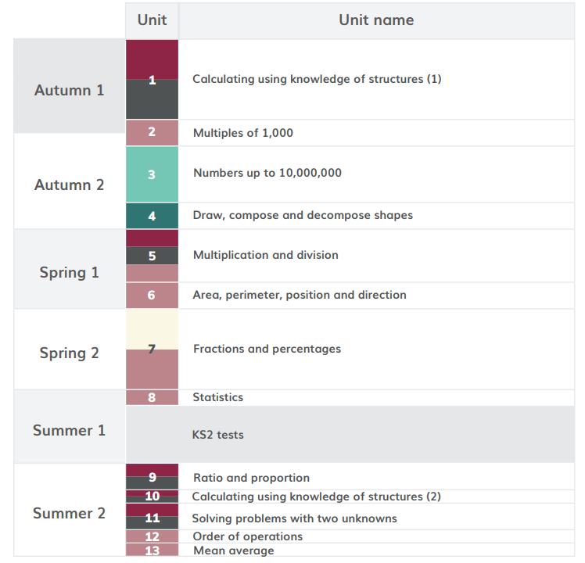
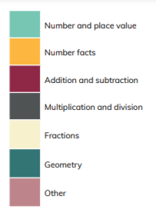
HoH Academic year
*Please note than these are approximate dates based on Leicestershire term dates. This plan will help to keep teachers on track with coverage but teachers may makes slight changes based on monitoring and assessment. This plan will be reviewed in Sept 22.
≈6 WEEKS Aug 30th – 8th Oct
≈ 2 WEEKS 11th Oct-– Oct 29th
≈ 4 WEEK 15th Nov- 3rd Dec
≈ 2 WEEKS 6th Dec- 17th Dec
≈4 WEEKS Jan 3rd -28th Jan
≈2 WEEKS
31st Jan- 11th Feb
≈6 WEEKS
21st Feb- April 1st
≈1 WEEK
April 4th- April 8th
Total of 7 weeks

Slide 2
https://www.ncetm.org.uk/classroom-resources/cp-year-6-curriculum-map/
Links to online materials to support planning
unit | Time allocation | Main Focus and link to materials to support planning | Links to Maths Guidance | Links to PD materials
1 | ≈6 WEEKS Aug 30th – 8th Oct | Calculating using knowledge of structures | 6AS/MD1 6AS/MD2 | 1.28 Common structures and the part-part-whole relationship 1.29 Using equivalence and the compensation category to calculate
2 | ≈ 2 WEEKS 11th Oct-– Oct 29th | Multiples of 1000 | n/a | 1.26 Multiples of 1,000 up to 1,000,000
3 | ≈ 4 WEEK 15th Nov- 3rd Dec | Numbers up to 10,000,000 | 6NPV1 6NPV2 6NPV 3 6NPV 4 | 1.30 Numbers up to 10,000,000
4 | ≈ 2 WEEKS 6th Dec- 17th Dec | Draw, compose and decompose shapes | 6G1 | See Maths Guidance for 6G1
5 | ≈4 WEEKS Jan 3rd -28th Jan | Multiplication and Division | 6AS/MD2 | 2.18 Using equivalence to calculate 2.23 Multiplication strategies for larger numbers and long multiplication2.24 Division: dividing by two-digit numbers 2.25 Using compensation to calculate

Slide 3
https://www.ncetm.org.uk/classroom-resources/cp-year-6-curriculum-map/
Links to online materials to support planning
unit | Time allocation | Main Focus and link to materials to support planning | Links to Maths Guidance | Links to PD materials
6 | ≈2 WEEKS 31st Jan- 11th Feb | Area, perimeter, position and direction | n/a | 2.30 Multiplicative contexts: area and perimeter 2
7 | ≈6 WEEKS 21st Feb- April 1st | Fractions and percentages | 6F 1 6F 2 6F 3 | 3.7 Finding equivalent fractions and simplifying fractions 3.8 Common denomination: more adding and subtracting 3.9 Multiplying fractions and dividing fractions by a whole number 3.10 Linking fractions, decimals and percentages
8 | ≈1 WEEK April 4th- April 8th | Statistics | This topic is part of the national curriculum but is not included in the DfE 2020 guidance or the NCETM Mastery PD Materials. There are no NCETM classroom slides to download for this unit. https://www.ncetm.org.uk/classroom-resources/cp-year-6-unit-8-statistics/
9 | ≈2 WEEKS 25th April- 6th May | Ratio and Proportion | 6AS/ MD 3 | 2.27 Scale factors, ratio and proportional reasoning
SATS
continued

Slide 4
unit | Time allocation | Main Focus and link to materials to support planning | Links to Maths Guidance | Links to PD materials
10 | ≈1 WEEK 16th May- 20th May | Calculating using knowledge of structure | 6AS/MD-2 | 1.29 Using equivalence and the compensation property to calculate
11 | ≈2 WEEKS 23rd May- 10th June | Solving problems with two unknowns | 6AS/MD-4 | 1.31 Problems with two unknowns
12 | ≈1 WEEK 13th June- 17th June | Order of operations | n/a | 2.22 Combining multiplication with addition and subtraction 2.28 Combining division with addition and subtraction
13 | ≈1 WEEK 20th June- 24th June | Mean average | n/a | 2.26 Mean average and equal share

